Slide 1
Implementing Subprograms
Subprogram call and return operations of a language are together called its subprogram linkage
A subprogram call in a typical language must:
  process must whatever parameter-passing method is used
  create local variables (if needed) by allocating storage and binding those variables to that storage
  save the execution status of the calling program unit
    this includes register values, CPU status bit
  arrange to transfer control to the subprogram and ensure that control
  can return to the proper place when the subprogram execution is completed
  make non-local variables visible to the called subprogram (if nested subprograms are allowed like in Ada)

Slide 2
Subprograms Returns
On termination a subprogram must:
  move the local values of the associated formal parameters to the actual parameters for out or inout mode semantics
  it must deallocate the storage used for local variables
  Restore the execution status of the calling program unit
  control must be returned to the calling program unit

Slide 3
Implementing Simple Subprograms
simple means (FORTRAN 77) that subprograms cannot be nested and all local variables are static
Call Semantics:
  Save the execution status of the caller
  Carry out the parameter-passing process
  Pass the return address
  Transfer control to the callee
Return Semantics:
  If pass-by-value-result parameters are used, move the current values of those parameters to their corresponding actual parameters
  If it is a function, move the functional value to a place the caller can get it
  Restore the execution status of the caller
  Transfer control back to the caller
Required Storage:
  Status information of the caller, parameters, return address, and functional value (if it is a function

Slide 4
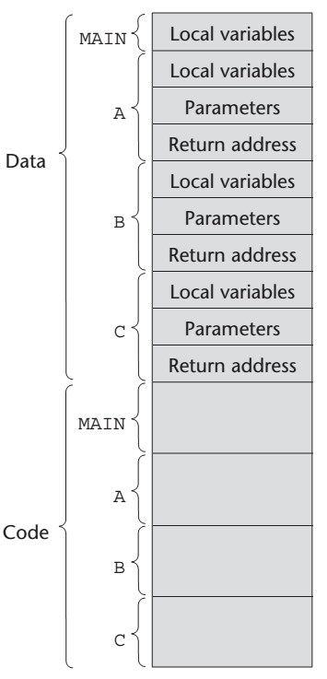
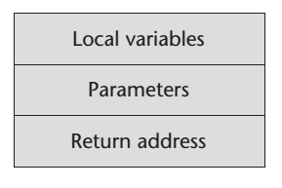
Static Activation Records
The format, or layout, of the non-code part of an executing subprogram is called an activation record
An activation record instance is a concrete example of an activation record (the collection of data for a particular subprogram activation)
FORTRAN 77 subprograms can have no more than one activation record instance at any given time
The code of all of the program units of a FORTRAN 77 program may reside together in memory, with the data for all units stored together elsewhere
The alternative is to store all local subprogram data with the subprogram code
Can be statically allocated because it has a fixed size

Slide 5
Activation Record Etc
The collection of dynamic links in the stack at a given time is called the dynamic chain, or call chain
Local variables can be accessed by their offset from the beginning of the activation record. This offset is called the local_offset
The local_offset of a local variable can be determined by the compiler
Assuming all stack positions are the same size, the first local variable declared has an offset of three plus the number of parameters

Slide 6
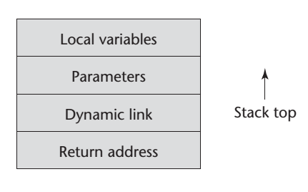
Implementing Subprograms in
ALGOL-like Languages
This is more complicated than implementing FORTRAN 77 subprograms because:
  Parameters are often passed by two methods
  Local variables are often dynamically allocated
  Recursion must be supported
  Static scoping must be supported
The activation record format is static, but its size may be dynamic
The dynamic link points to the top of an instance of the activation record of the caller
An activation record instance is dynamically created when a subprogram is called

Slide 7
Run-time Stack
The format of the activation record is fixed at compile time, although its size may depend on the call in some languages (with variable length parameters)
Because the call and return semantics specify that the subprogram last called is the first to complete (LIFO), it is reasonable to create instances of these activation records on a stack
This stack is part of the runtime system and therefore is called the run-time stack
Every subprogram activation, whether recursive or nonrecursive, creates a new instance of an activation record on the stack
This provides the required separate copies of the parameters, local variables, and return address
Gets really nasty when nested subroutines are allowed

Slide 8
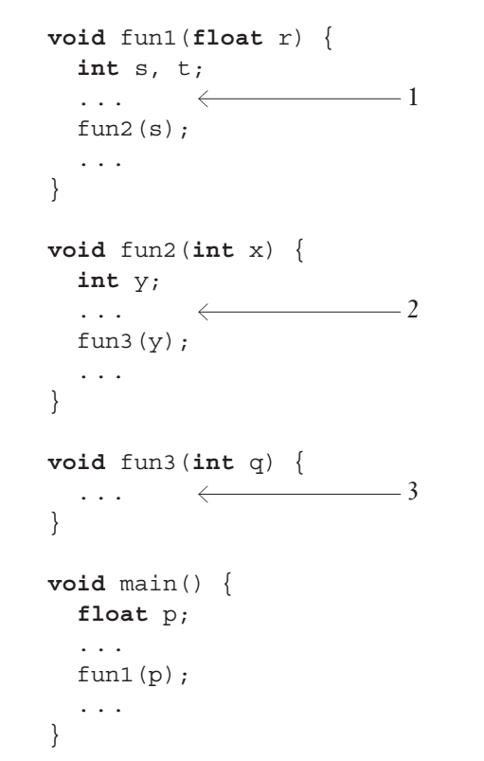
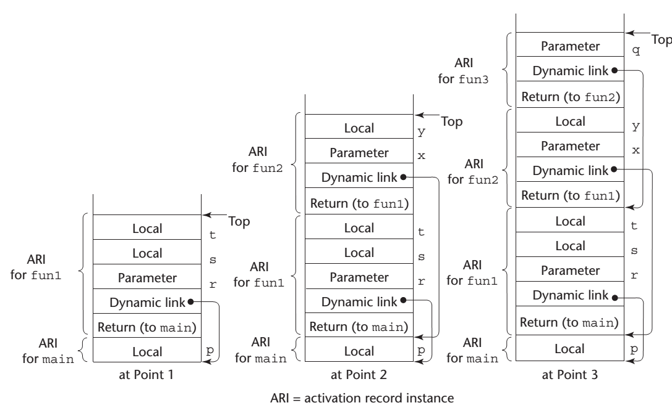
Java-like Example

Slide 9
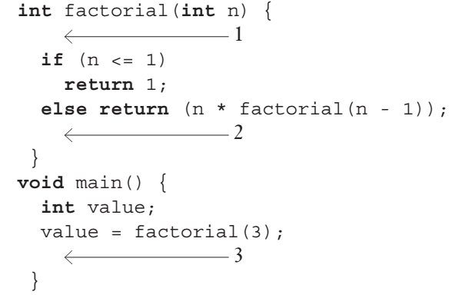
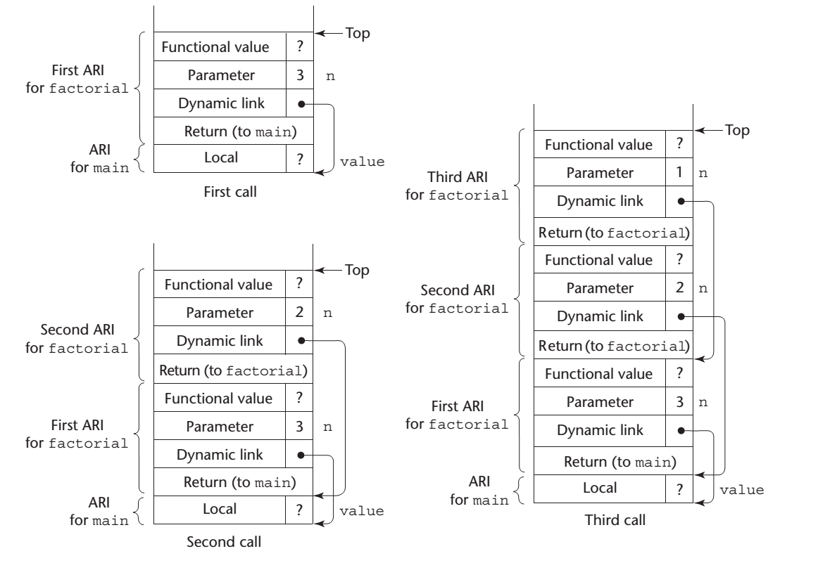
With Recursion
Fanciful example from the book. Not quite reality.

Slide 10
Assembler Example
strlen proc
push bp
mov bp, sp
mov si, [bp+4]
mov bx, 0
L2: cmp byte ptr [si+bx], '$'
je done2
inc bx
jmp L2
done2:
mov ax, bx
pop bp
ret 2
strlen endp
lea bx, string1
push bx
call strlen
call putdec
_putch 13,10
;;;;;;;;;;;;;;;;;;;;;;;;;;;;;;;
SP ➔ BX ;BP + 4
SP => IP ;BP + 2
SP => BP = SP ;BP

Slide 11
Nested Subprograms
Fortran 95+, Ada, Python, JavaScript, Ruby, and Lua, as well as the functional languages allow nested subprograms
A reference to a nonlocal variable in a static-scoped language with nested subprograms requires a two-step access process
All nonstatic variables that can be non-locally accessed are in existing activation record instances and therefore are somewhere in the stack
The first step of the access process is to find the instance of the activation record in the stack in which the variable was allocated
The second part is to use the local_offset of the variable (within the activation record instance) to access it.

Slide 12
Nested Subprograms
Finding the correct activation record instance is the more interesting and more difficult of the two steps
First, note that in a given subprogram, only variables that are declared in static ancestor scopes are visible and can be accessed
Also, activation record instances of all of the static ancestors are always on the stack when variables in them are referenced by a nested subprogram
Quite impossible for a nested subprogram to be called if its static ancestor is not active because it is only visible in that scope
Semantics of nonlocal references dictates that the correct declaration
is the first one found when looking through the enclosing scopes, most closely nested first
Accomplished using static chains

Slide 13
Static Chains
The most common way to implement static scoping in languages that allow nested subprograms is static chaining
In this approach, a new pointer, called a static link, is added to the activation record
The static link points to the bottom of the activation record instance of an activation of the static parent
It is used for accesses to nonlocal variables
Typically, the static link appears in the activation record below the parameters
The static link in an activation record instance for subprogram A points to one of the activation record instances of A's static parent
A static chain is a chain of static links that connects certain activation record instances
The static chain from an activation record instance connects it to all of its static ancestors

Slide 14
Following the Chain
Finding the correct activation record instance of a nonlocal variable using static links is relatively straightforward
When a reference is made to a nonlocal variable, the activation record instance containing the variable can be found by searching the static chain until a static ancestor activation record instance is found that contains the variable
Because the nesting of scopes is known at compile time, the compiler can determine not only that a reference is nonlocal but also the length of the static chain
Static_depth is an integer associated with a static scope whose value is the depth of nesting of that scope (main = 0, sub1 below main = 1, sub2 nested in sub1 = 2)

Slide 15
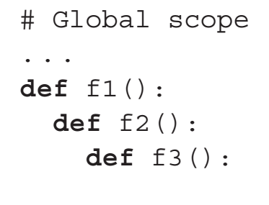
Chain Offset
The chain_offset or nesting_depth of a nonlocal reference is the difference between the static_depth of the reference and that of the scope where it is declared
A reference can be represented by the pair:
  (chain_offset, local_offset)
The static_depths of the global scope, f1, f2, and f3 are 0, 1, 2, and 3
procedure f3 to f1, the chain_offset = 2
f3 to f2, the chain_offset =1

Slide 16
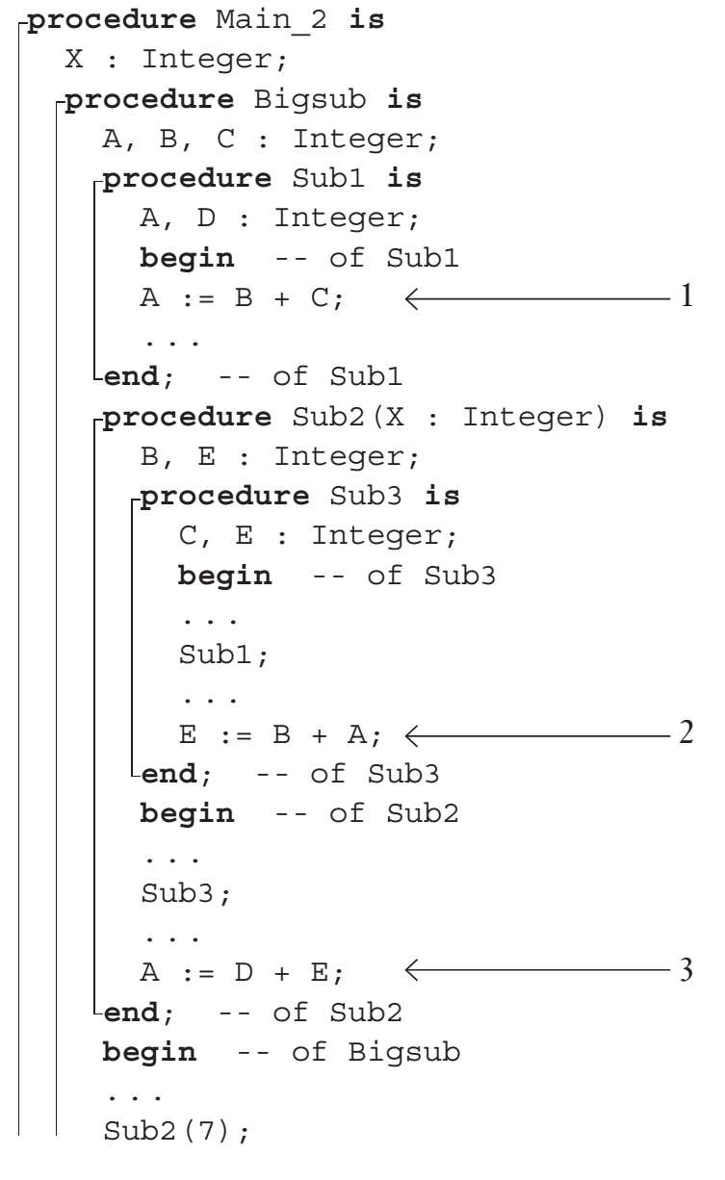
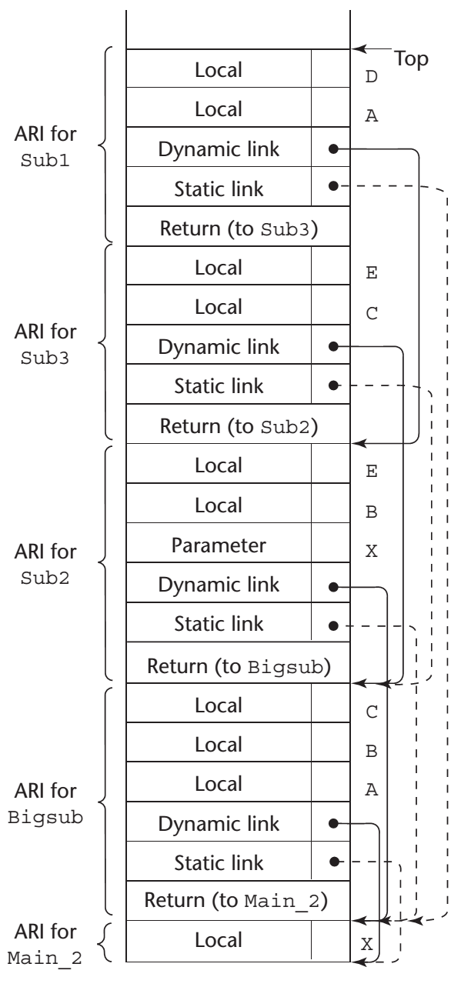
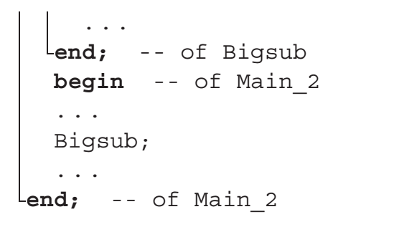
Ada Example
(1) In Sub1 A is local offset (0,3)
B is to the nonlocal B from Bigsub - (1, 4)
C is nonlocal (1,5)
(2) E is local (0,4)
B is from Sub2 offset (1,4)
A is Bigsub offset (2,3)
(3) A is from Bigsub (1,3)
Reference to D is error
E is from Sub2 is local (0,5)

Slide 17
Static Chain Maintenance
At the call (assume there are no parameters that are subprograms and no pass-by-name parameters:
  The activation record instance must be built
  The dynamic link is just the old stack top pointer
  The static link must point to the most recent ari of the static parent (in most situations)
Two Methods:
  Search the dynamic chain until the first ari for the static parent is found--easy, but slow
  Treat procedure calls and definitions like variable references and definitions (have the compiler compute the nesting depth, or number of enclosing scopes between the caller and the procedure that declared the called procedure; store this nesting depth and send it with the call)

Slide 18
Evaluation of the Static Chain Method
Two problems:
  A nonlocal reference is slow if the number of scopes between the reference and the declaration of the referenced variable is large
  Time-critical code is difficult, because the costs of nonlocal references are not equal, and can change with code upgrades

Slide 19
Implementing Blocks
A block is specified in the C-based languages as a compound statement that begins with one or more data definitions
Blocks can be implemented by using the static-chain process
Treat blocks as parameterless subprograms
  use activation records
  amount of space can be allocated after the local variables in the activation record
  offsets for all block variables can be statically computed, so block variables can be addressed exactly as if they were local variables

Slide 20
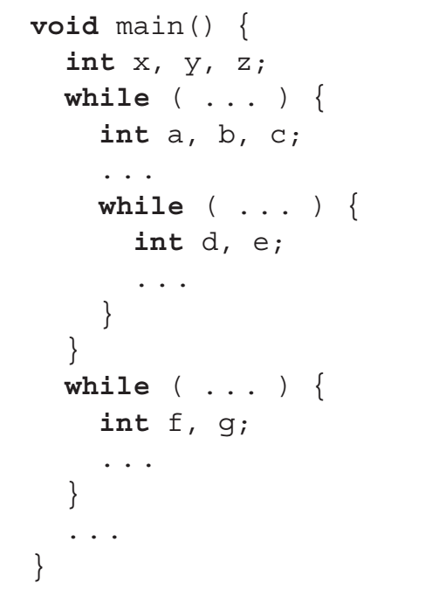
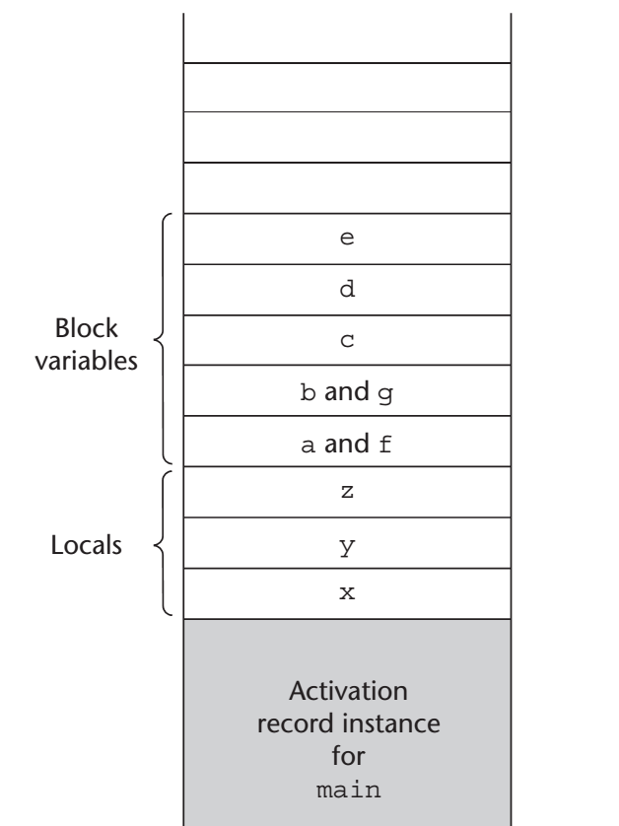
C-based Example
f and g occupy the same memory locations as a and b, because a and b are popped off the stack when their block is exited

